Slide 1

BS – 101 Engineering Physics
Lecture – 12
Engr. Safee Ullah

Slide 2
Magnetic Force on a Current Carrying Conductor
What makes an electric motor work?
Within the motor are conductors that carry currents (that is, whose charges are in motion), as well as magnets that exert forces on the moving charges.
Hence there is a magnetic force on each current-carrying conductor, and these forces make the motor turn.

Slide 3
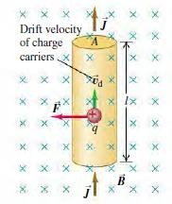
Magnetic Force on a Current Carrying Conductor (Contd.)
We can compute the force on a current-carrying
conductor starting with
𝑭 =
the magnetic force
𝑞 𝒗 × 𝑩 on a single moving charge.
Figure shows a straight segment of a conducting wire, with length l and cross-sectional area A;

Slide 4
Magnetic Force on a Current Carrying Conductor (Contd.)
The current is from bottom to top.
The wire is in a uniform magnetic field B, perpendicular to the plane of the diagram and directed into the plane.
Let’s assume first that the moving charges are positive.

Slide 5
Magnetic Force on a Current Carrying Conductor (Contd.)
The drift velocity 𝑣_{𝑑} is upward, perpendicular to B.
The average force on each charge is 𝑭 = 𝑞 𝒗_{𝒅} × 𝑩 , directed to the left as shown in the figure.
Since 𝑣_{𝑑} and B are perpendicular, the magnitude of the force is
𝐹 = 𝑞𝑣_{𝑑}𝐵.

Slide 6
Magnetic Force on a Current Carrying Conductor (Contd.)
The number of charges per unit volume, or charge concentration, is n; a segment of conductor with length l has volume Al and contains a number of charges equal to nAl. The total force F on all the moving charges in this segment has magnitude
𝐹 = 𝑛𝐴𝑙 𝑞𝑣_{𝑑}𝐵

Slide 7
Magnetic Force on a Current Carrying Conductor (Contd.)
𝐹 = 𝑛𝐴𝑙 𝑞𝑣_{𝑑}𝐵
𝐹 = 𝑛𝑞𝑣_{𝑑}𝐴 𝑙𝐵
The current density was;
𝐽 = 𝑛𝑞𝑣_{𝑑}
The product 𝐽𝐴
total current 𝐼.
𝐹 = 𝐼𝑙𝐵𝑠𝑖𝑛 𝜑
is the

Slide 8
Magnetic Force on a Current Carrying Conductor (Contd.)

Slide 9
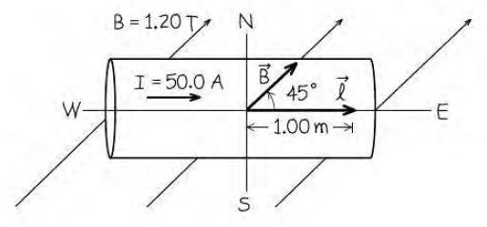
Magnetic Force on a Straight Conductor
A straight horizontal copper rod carries a current of 50.0 A from west to east in a region between the poles of a large electromagnet. In this region there is a horizontal magnetic field toward the northeast (that is, 45° north of east) with magnitude
1.20 T.
(a) Find the magnitude and direction of the force on a 1.00-m
section of rod.
(b) While keeping the rod horizontal, how should it be oriented to maximize the magnitude of the force? What is the force magnitude in this case?
F=42.4N, 60N

Slide 10
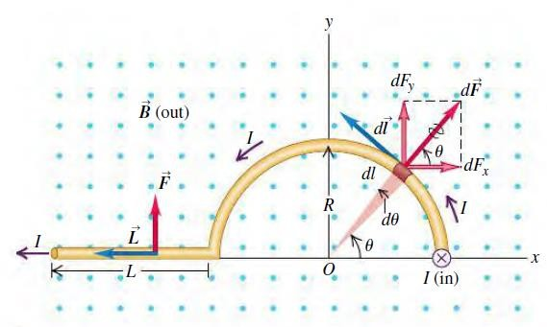
Magnetic Force on a Curved Conductor
In Fig. the magnetic field B is uniform and perpendicular to the plane of the figure, pointing out of the page. The conductor, carrying current 𝐼 to the left, has three segments:
(1) a straight segment with length 𝐿 perpendicular to the plane of the figure,
(2) a semicircle with radius R, and
(3) another straight segment with length 𝐿 parallel to the x-axis.
Find the total magnetic force on this conductor.
e

